Slide 1
Improving Video Activity Recognition using Markov Logic Networks
Niranjan Viladkar and Kaustubh Kulkarni Under the guidance from Dr. Parag Singla Department of Computer Science, IIT Delhi
M.Tech Project Presentation – February 21, 2014

Slide 2
Overview
Quick recap of the approach
Results of first stage
Work done in winter and this semester
MLN Theory

Slide 3
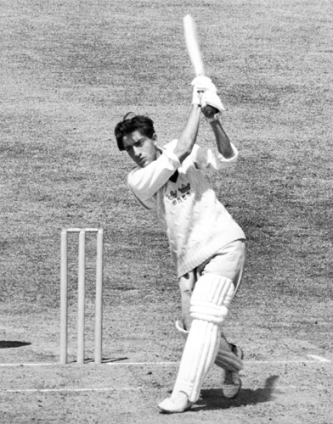
Recap - Problem Statement
What is Video Activity Recognition?
Play

Slide 4
Recap - Approach
Classification based on HoGHoF features
Confidence of Objects using Object Detection
Probabilistic Inference Logic using MLN
Predictions

Slide 5
Recap - Classification using HoGHoF
Describe a video clip as bag-of-features.
Cluster all HoGHoF feature descriptors using k-means.
Represent clip as a histogram over these clusters
Train a classifier
Supervised - Dataset is pre labeled
Output – Average Precisions for each activity

Slide 6
Result – First Stage

Slide 7
Recap - Approach
Classification based on HoGHoF features
Confidence of Objects using Object Detection
Probabilistic Inference Logic using MLN
Predictions

Slide 8
Recap – Object Detection
Using Discriminatively Trained Deformable Part Models
Pre-trained object detector for 19 objects
aeroplane, bicycle, bird, boat, bottle, bus, car, cat, chair, cow, dining table, dog, horse, motorbike, potted plant, sheep, sofa, train, tv monitor
Output – Confidence of object being present in selected frames from the video

Slide 9
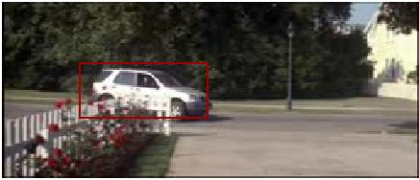
Output of Object Detector
FRAME 1 car -0.181786 . . .

Slide 10
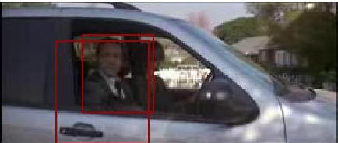
Output of Object Detector
FRAME 1 car -0.181786 . . .
FRAME 151 person 0.579786 person -0.593087

Slide 11
TODO – Kaustubh

Slide 12
Winter and This Semester
Done - Object Detection
Under Progress - Markov Logic Network study and implementation.

Slide 13
Current Status
Classification based on HoGHoF features
Probability of Objects using Object Detection
Probabilistic Inference Logic using MLN
Predictions

Slide 14
Finally
Classification based on HoGHoF features
Probability of Objects using Object Detection
Probabilistic Inference Logic using MLN
Predictions

Slide 15
References
Actions in Context by M. Marszalek, I. Laptev and C. Schmid; in Proc. CVPR-2009
Improving Video Activity Recognition using Object Recognition and Text Mining by Tanvi Motwani and Raymond J. Mooney, ECAI-2012
Markov Logic by Pedro Domingos, Parag Singla, et.al., Probabilistic Inductive Logic Programming (pp. 92-117), 2008. New York: Springer.

